Slide 1






Human Resources Analysis
Digital Egypt Pioneers

Slide 2










Meet Our Team
Abdelrhman Mohamed
Mostafa Mohamed
Hazem Ahmed
Omar Hegazy

Slide 3





Table Of Contents
01
02
03
SUMMARY
INTRO & GOALS
DATA PREPROCESING
04
05
06
INSIGTHS
DATA ANALYSIS
DASHBOARD

Slide 4







01
Summary

Slide 5




Summary
This project focuses on analyzing employee performance and relationships within the company through HR data. It examines employee evaluations based on their salaries, feedback from their managers, and annual promotions. The goal is to assess the overall performance of staff and identify trends or correlations between compensation, managerial evaluations, and career progression.

Slide 6

02
Intro & Goals

Slide 7
Introduction
This project focuses on analyzing the HR data of a company to gain a comprehensive understanding of employee demographics, salary trends, promotions, and work-life factors. By examining key areas such as employee turnover, salary distributions across gender and ethnicity, and correlations between education, marital status, and overtime, the project aims to provide data-driven insights. It will also explore employee-manager relationships through performance ratings and the impact of training opportunities on promotions and salaries. Various statistical methods and visual representations will be used to identify trends and patterns in the data.

Slide 8
Objectives
Analyze Age and Tenure:
Calculate the average, highest, and lowest employee ages.
Identify the year with the highest employee turnover.
Calculate the average duration employees have been with the company.
Explore the correlation between years at the company
and marital status, as well as years at the company and salary.
Examine Salary Distribution:
Analyze salaries based on gender and ethnicity.
Identify the highest-paid department and job role.
Investigate the relationship between marital status and salaries,
as well as distance from home and overtime.

Slide 9
Objectives
Department and Role Analysis:
Determine the department with the fastest promotions.
Assess the average age of employees by state.
Analyze the correlation between work-life balance and marital status.
Performance and Promotions:
Examine the relationship between manager ratings and promotions.
Calculate the difference between self-ratings and manager ratings.
Evaluate the correlation between training opportunities taken and salaries or promotions.
Visualize Employment Trends:
Use a line chart to display hire dates by employee count.
Present marital status distribution with a pie chart, highlighting any correlation with salaries and overtime.

Slide 10
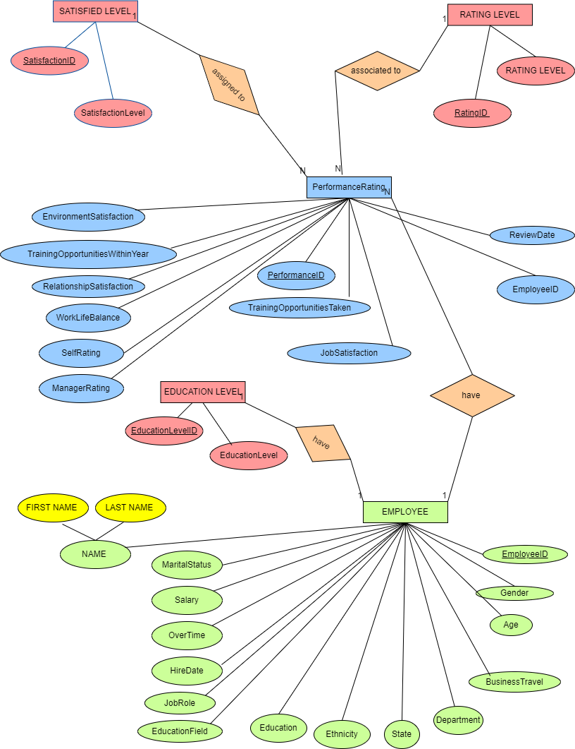
ERD

Slide 11
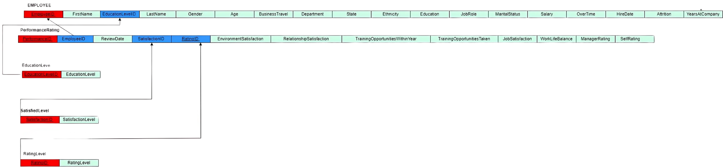
Mapping

Slide 12
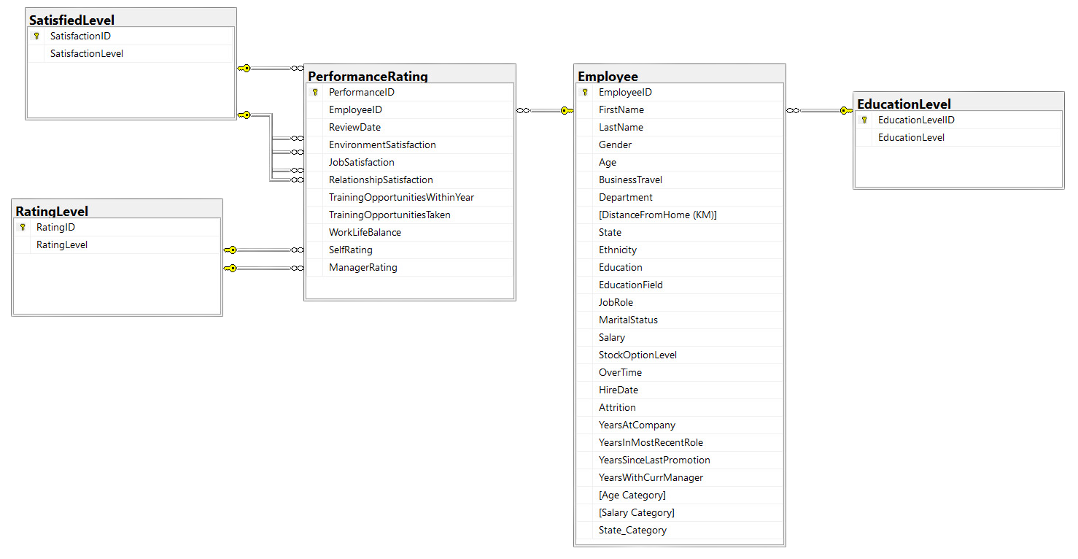
DB – Diagram

Slide 13

03
Data Cleaning

Slide 14
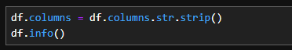
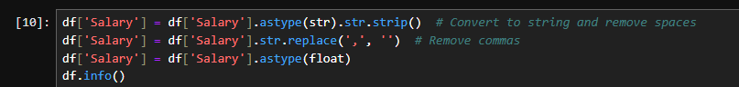
Data Cleaning with Python
Performed data cleaning using Python to prepare the dataset for analysis.
Corrected the data types for the "Salary" and "Hire Date" columns.

Slide 15
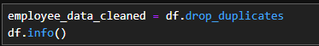
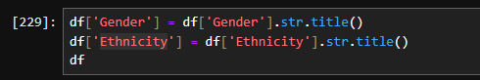
Data Cleaning with Python
Removed duplicates to ensure the dataset was free of redundancy.
Applied standardization to columns like "Gender" and "Ethnicity" for consistency.

Slide 16
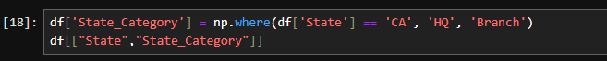
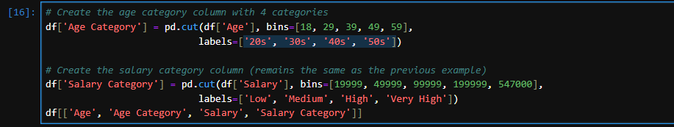
Data Cleaning with Python
Grouping the State column into "Head Quarter" and "Branch.“
Created calculated columns, including : Dividing age into categories ('20s', '30s', '40s', '50s').

Slide 17

04
Insights

Slide 18
Insights
Average Age, Highest, and Lowest Age
Highest Department Salary and Job Role
Average Salary by Ethnicity
State by Salary and Count of Employees
Correlation between Education Levels and Salary
Highest Paid Role and Department
Pie Chart of Marital Status and Correlation with Salaries
Correlation between Marital Status and Overtime
Total Salaries
Correlation between Distance from Home and Overtime
Hire Date by Count of Employees (Line Chart)
Identify the year with the highest employee turnover.
Analyze salaries based on gender.
Calculate the average duration employees have been with the company.
Explore the correlation between years at the company and marital status.
Investigate the relationship between years at the company and salaries.
Determine the department with the fastest promotions.
Assess the average age of employees by state.
Analyze the correlation between work-life balance and marital status.
Examine the relationship between manager ratings and promotions.
Calculate the difference between self-ratings and manager ratings.
Evaluate the correlation between training opportunities taken and salaries or promotions.

Slide 19
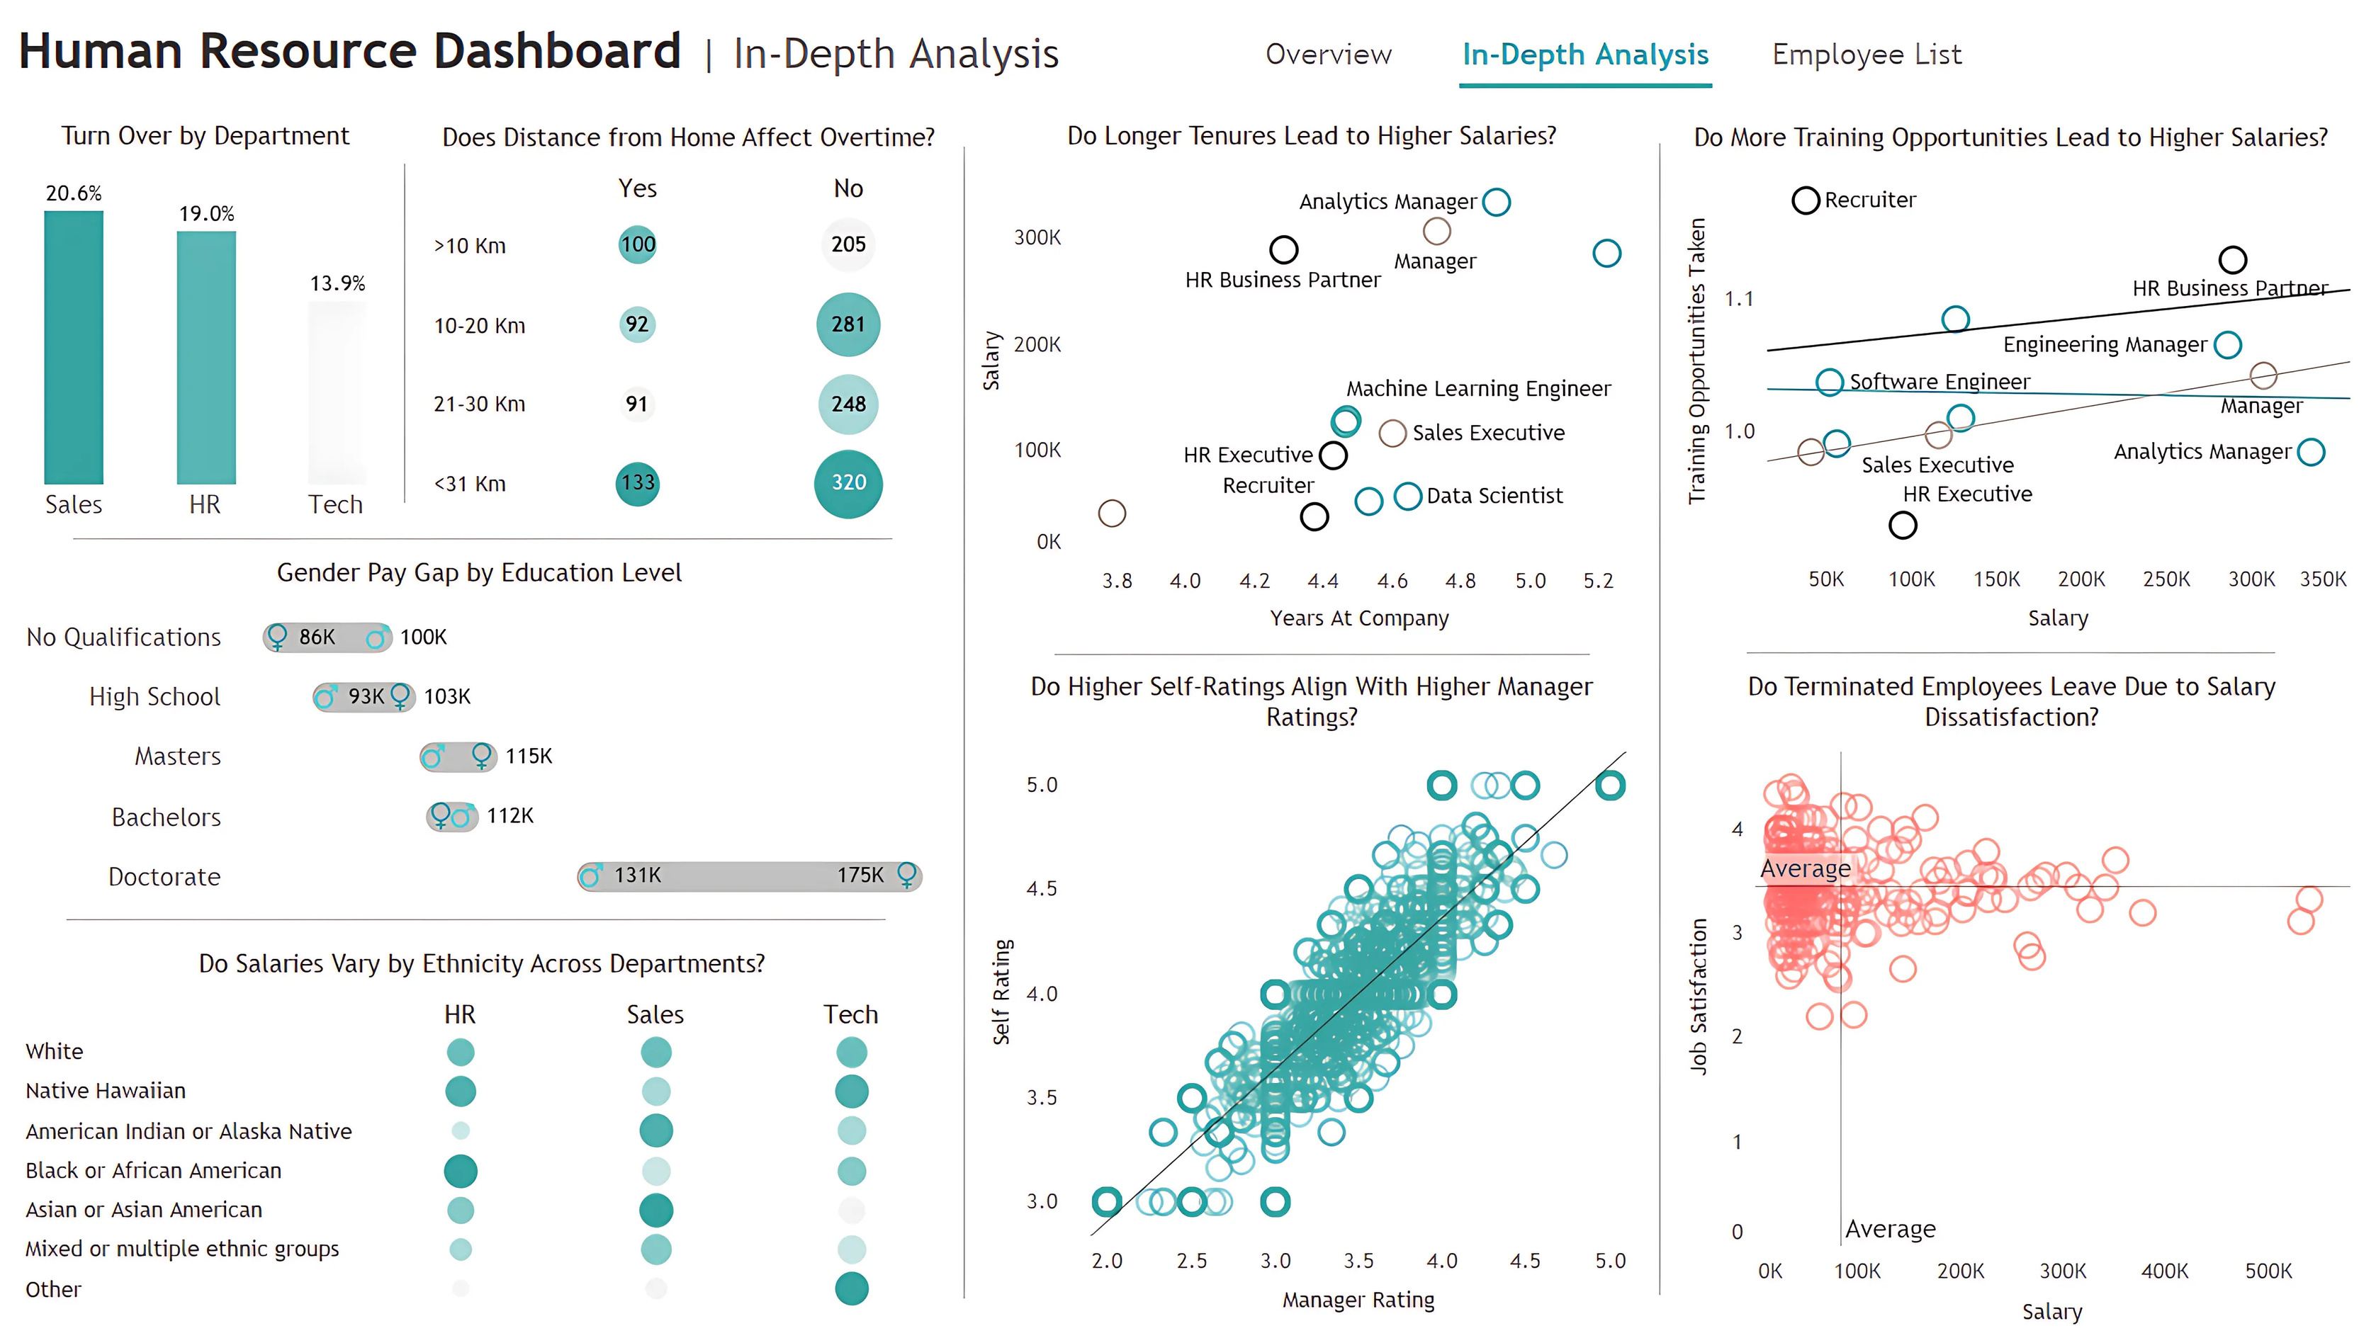
This chart illustrates that the impact of training on salary varies by job role. In some cases, like HR and senior engineering roles, more training correlates with higher salaries. In other roles, such as machine learning or analytics management, other factors might play a more significant role in determining salary.

Slide 20

There are clear differences in salary based on ethnicity and department.
Sales appears to offer the highest earning potential across different ethnicities, while Human Resources shows more disparity with lower salaries for certain groups like American Indian and Mixed or multiple ethnic groups.
Technology presents a mix, with some groups like Other earning more, while Asian and Black or African American employees earn less than in Sales.

Slide 21

05
Data Analysis

Slide 22
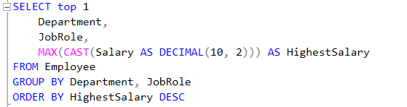
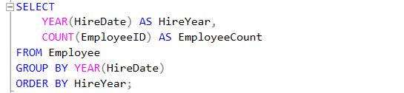
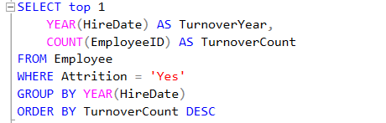
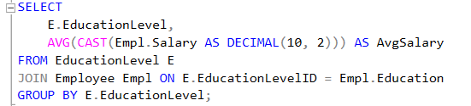
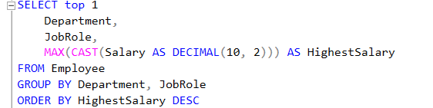
Data Analysis by SQL

Slide 23

06
Dashboard

Slide 24
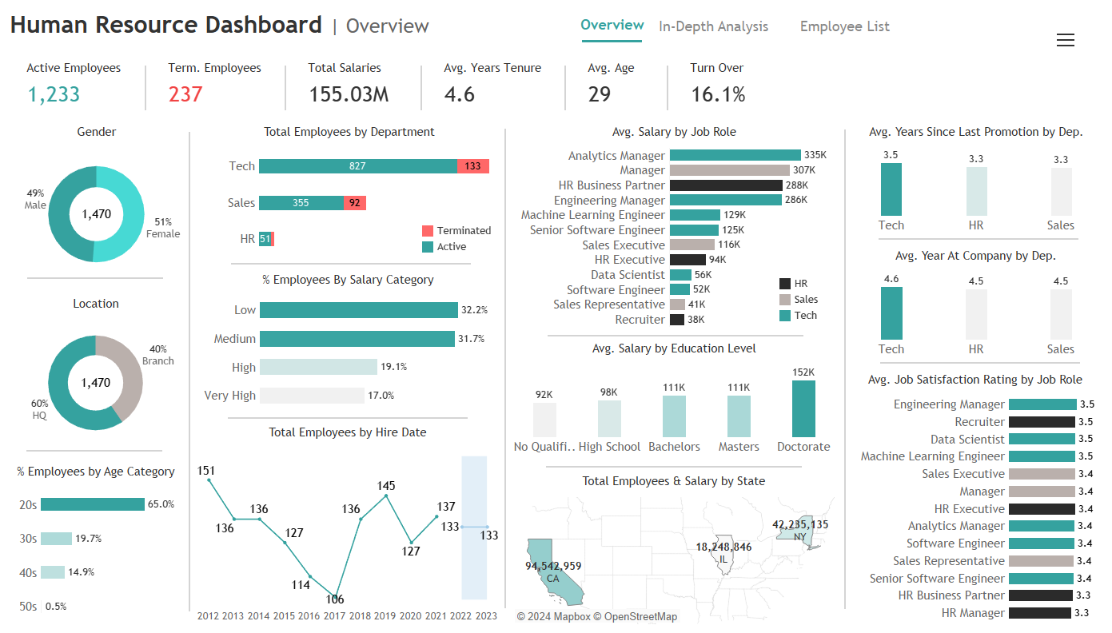

Slide 25


Slide 26
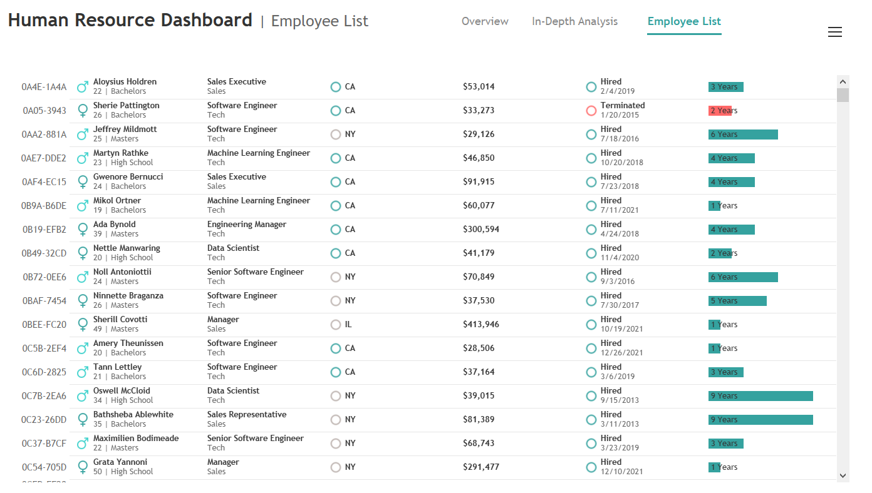

Slide 27
Thank You!

